Slide 1
Mental set
https://www.youtube.com/watch?v=1EujGmHPT3k
Notes:
hook

Slide 2
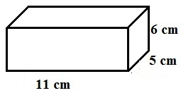
24
7
30
Date
Volume
EQ – How do you find the volume of 3D shapes
Volume is the space a 3D shape occupies
To find the volume
Find the area of the cross-section
Multiply by the height
Eg.
Area = L x W
= 11 x 6
= 66 cm²
Volume = A x H
= 66 x 5
= 330cm³
V = L x W x H
5
Notes:
Input

Slide 3
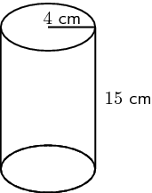
24
7
30
Date
Volume
EQ – How do you find the volume of 3D shapes
Cylinders
Find the area of the circle
Multiply by height
Area = 𝝅r²
= 𝝅 4²
= 50.26cm²
Volume = A x H
= 50.26 x 15
= 753.9cm³
V = 𝝅 r² h
5
Notes:
Input

Slide 4
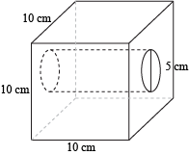
24
7
30
Date
Volume
EQ – How do you find the volume of 3D shapes
Composite shapes
Find the area of the cross-section
Multiply by height
A1 = l x w
= 10 x 10 = 100
A2 = 𝝅r²
= 𝝅 2.5² = 19.63
A1–A2 = 100-19.63= 80.37cm²
Volume = A x H
= 80.37 x 10
= 803.7cm³
5
Notes:
Input

Slide 5
Activity
Dwyer pages 35 to 37
Nelson page 187
Q1, every 2nd; Q2 every 2nd; Q3 All
Nelson page 190
Q 16 & 17
Notes:
Independent practice

Slide 6
Closure activity
Complete your summary answering the EQ.
Notes:
Closure

